Slide 1
Module 6
Functions, Grouping & Filtering
MySQL

Slide 2
Topics covered
Aggregate Functions
Date Functions
String Functions
GROUP BY
HAVING

Slide 3
What are Functions in MySQL?
Functions perform calculations on data
Return a single value
Used in:
SELECT
WHERE
GROUP BY
HAVING

Slide 4
Types of functions
Aggregate Functions
Date Functions
String Functions

Slide 5
Aggregate Functions
Used to perform calculations on multiple rows.
Common functions:
COUNT()
SUM()
AVG()
MIN()
MAX()
Return single value from multiple rows

Slide 6
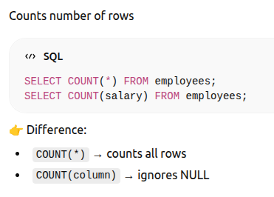
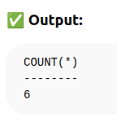
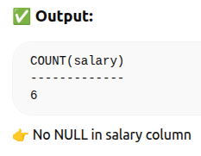
COUNT()

Slide 7
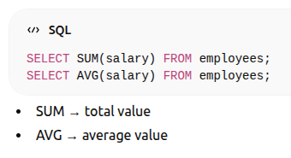
SUM() & AVG()

Slide 8
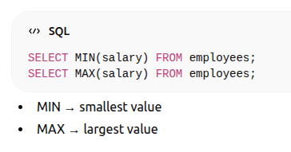
MIN() & MAX()

Slide 9
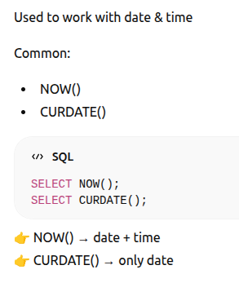
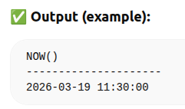
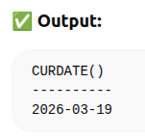
Date Functions

Slide 10
String Functions
Used to manipulate text
Common:
CONCAT()
IFNULL()

Slide 11
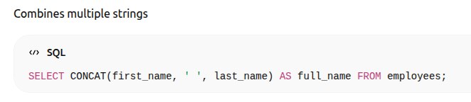
CONCAT()

Slide 12
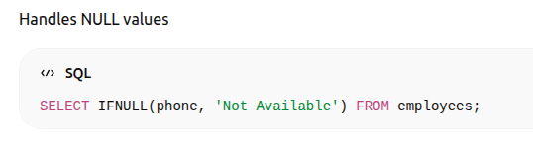
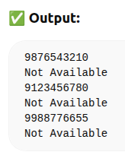
IFNULL()

Slide 13
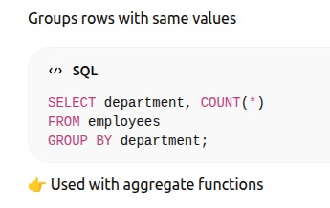
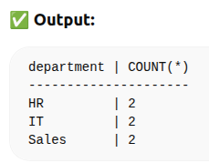
GROUP BY

Slide 14
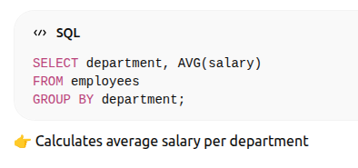
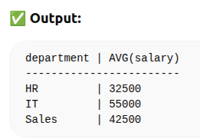
GROUP BY Example

Slide 15
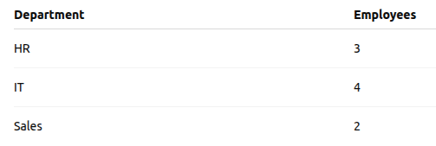
HAVING Clause

Slide 16
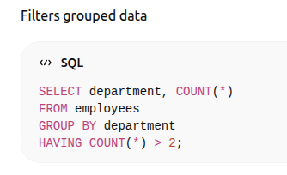
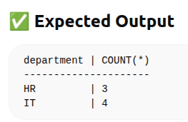
HAVING Clause

Slide 17
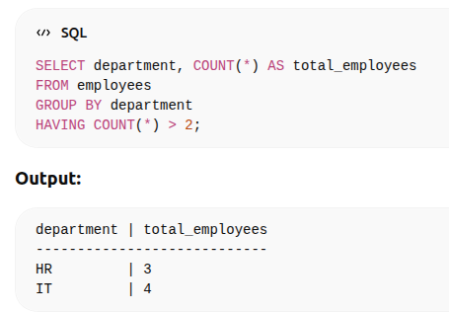
HAVING Clause

Slide 18
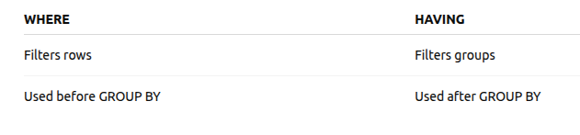
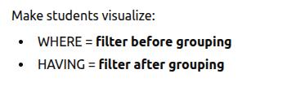
WHERE vs HAVING

Slide 19
Summary
Aggregate functions summarize data
Date & String functions manipulate data
GROUP BY groups rows
HAVING filters grouped results

